Slide 1
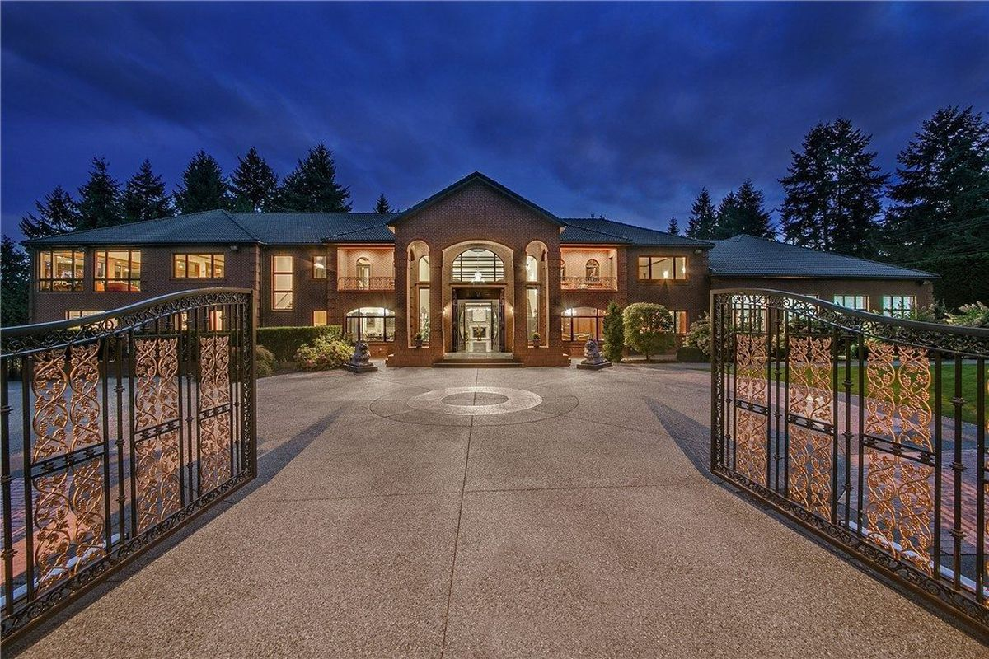

By Kaohsiung Dlamini
Mid –bootcamp project:
Real Estate Data Analysis

Slide 2
AGENDA
Project mission
Conclusion
Price predition model
Data insights
1.
2.
3.
4.

Slide 3

1. Project mission

Slide 4
Mission
Stakeholders: Senior management
Customer : Real Estate Company
Project : Building a predictive model for house prices based on certain features.
Market: Specific focus on the State of Washington in USA
Material: Thourough analysis of the business’s data for approx. 22 0000 sales from May 2014-May 2015
Client’s Objectives :
Being able to esatime the value of a house based on certain features.
Understanding what is driving the price for the high value houses (Above 650 K $ and above) .

Slide 5

2. Developped price
predition model

Slide 6
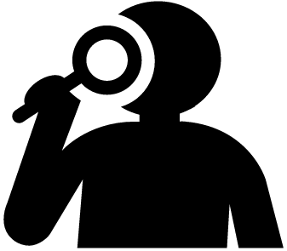
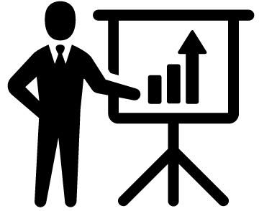
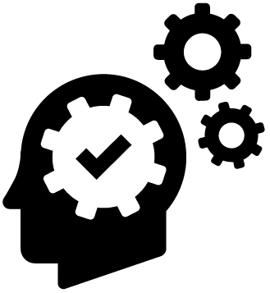
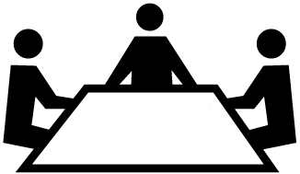
PROCESS IN 4 STEPS TO DEVELOP MODEL
Step 1:Data Cleaning
- Checked for duplicates
- Corrected format
-Checked missing data
Step 2: Sample validation
- Explored and visualized data
-Looked at charts
- Checked if sample is representatitive
-Spotted outliers
- Correlation analysis with the price.
Step 3: Predictive model
-Removed unnecessary columns
- Several methods were used like thelinear regression and KNN model however the one for which the model fit best was the decision tree with an accuracy of 76%
- Created a dashboard to see the companie’s evolution on their market
- Conclusions and final recommendations
Step 4: Implementation
Notes:
Step 1:
- Understanding objectives and incoming Customer Service flow
-Setting quantifiable goals with Gorgias
- Identifying difficulties faced during self onboarding
Step 2 - Ensuring all necesary intergration have been made.
--Clarifying what acesses each user has.
-Understanding your recurring questions account
-Setting up automation of your account
:
Step 3: -Resolving issues
-Identifying more tasks that can be automated
- Sending out helpful documentation or videos
Step 4:
- Data Analysis on progress pre onboarding process and end of onboarding
- Conclusions and final recommendations

Slide 7
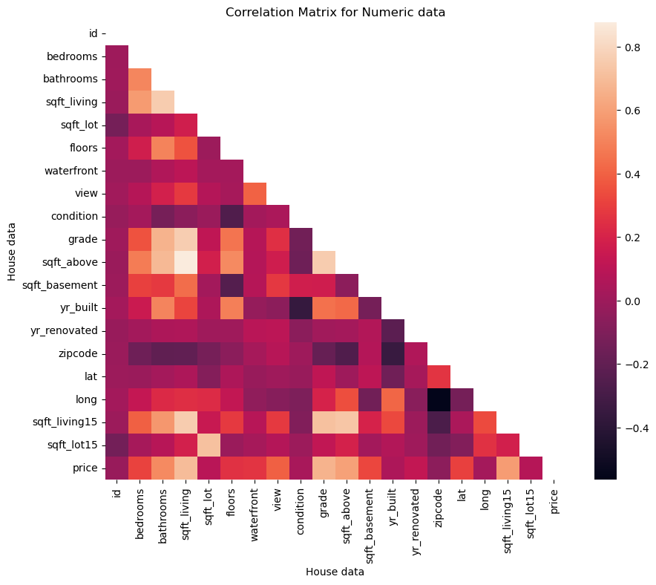
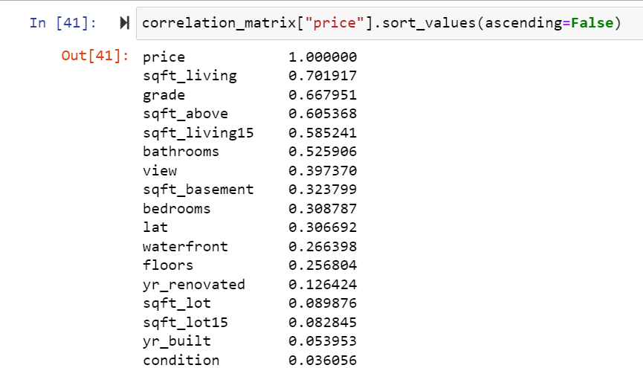
PROCESS IN 4 STEPS TO DEVELOP MODEL
Notes:
Step 1:
- Understanding objectives and incoming Customer Service flow
-Setting quantifiable goals with Gorgias
- Identifying difficulties faced during self onboarding
Step 2 - Ensuring all necesary intergration have been made.
--Clarifying what acesses each user has.
-Understanding your recurring questions account
-Setting up automation of your account
:
Step 3: -Resolving issues
-Identifying more tasks that can be automated
- Sending out helpful documentation or videos
Step 4:
- Data Analysis on progress pre onboarding process and end of onboarding
- Conclusions and final recommendations

Slide 8

3. Data insights

Slide 9

4. Conclusion

Slide 10
FINAL THOUGHTS/ RECOMMENTATION
Objective 1
FOR HIGH VALUE GOODS CRITERIAS WILL MAINLY BE :
Most recent houses built between 2000 -2020
Objective 2
MAIN FOCUS: AUTOMATION FOR PRICE
When a new house is listed by this real estate company they will quickly be able to estimate an adequate price.
NEXT STEP
Usage of Tableau Dashboard, to see the market evolution price wise and what customers are searching for in the Washington Market
Should have a grade between 8-9 with a average or good condition (above 2)
Should have approximately 343 sqft of living space with a waterfront and a basement.
Ideally would have 2 floors at the most.with 4 bedrooms and at least 2.5 bathrooms,
Same situation for their buyers , they will be able to estimate the most adequate price

Slide 11

.
Thank you for your attention

